Slide 1
Principles of Autonmoy and Decession Making
Final Project – RL Plays Game of Thrones
Hitesh Suresh

Slide 2
RL Plays Game of Thrones
Contents
Reinforcement Learning Plays Game of Thrones Chapter 1: A Game of Trials and Errors Chapter 2: Introduction to the Final Environment Chapter 3: The Path Becomes Clear
Building and Training a DQN Agent Introduction to the Problem Epsilon Decay Training Outputs

Slide 3
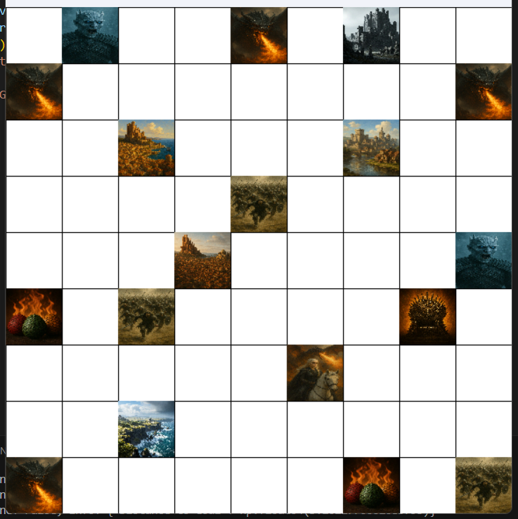
RL Plays Game of Thrones
Chapter 1: A Game of Trials and Errors
Complexity Level >>>> Knowledge
Size of the Environment = 9 X 9
Number of Hell States (H) = 9
Number of Reward States (R) = 3
Number of Kingdoms (K) = 5

Slide 4
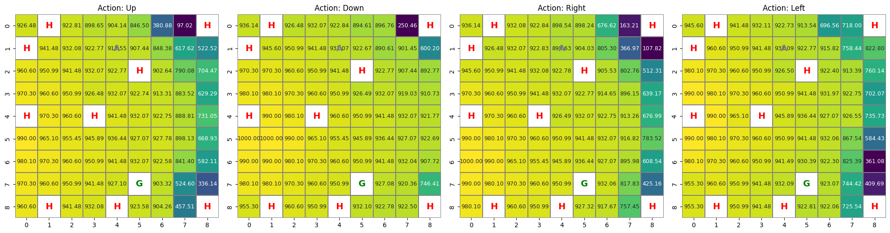
RL Plays Game of Thrones
A Game of Trials and Errors
Q-values are low and uniformly spread, indicating no strong preference for any action in most states
The agent is confused. It explores but doesn't learn. “A Traveler without a map”

Slide 5
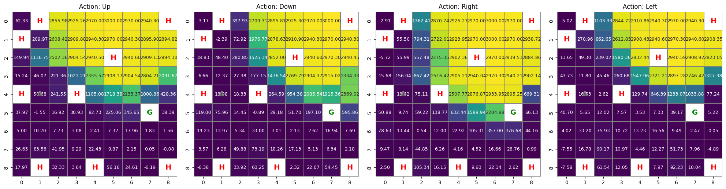
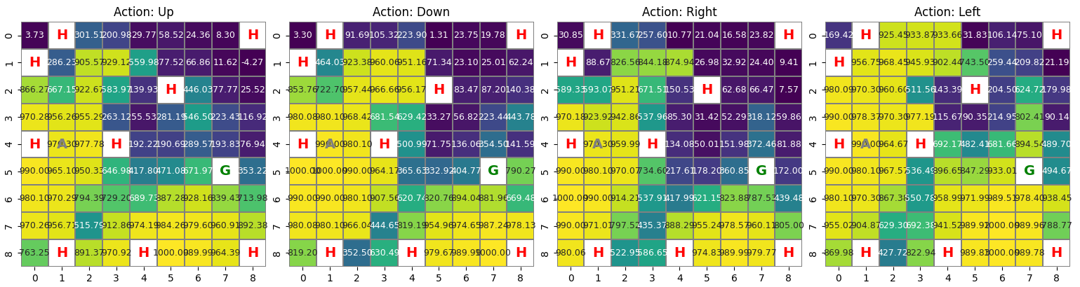
RL Plays Game of Thrones
A Game of Trials and Errors
Local minima →
Q table without random initialization

Slide 6
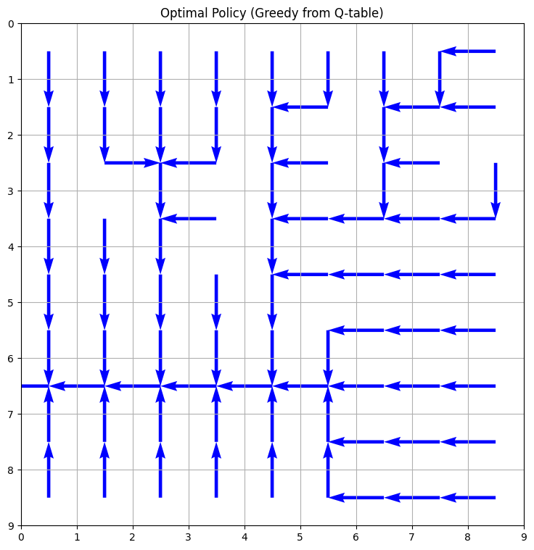
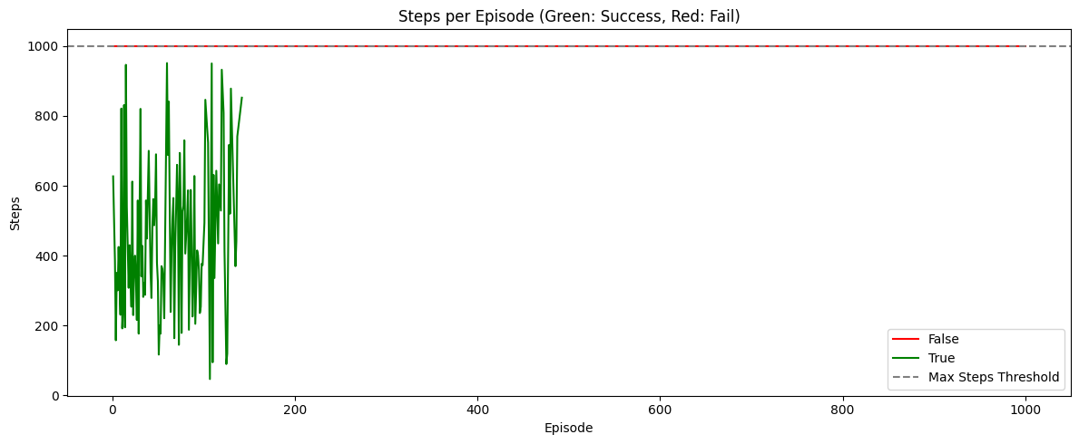
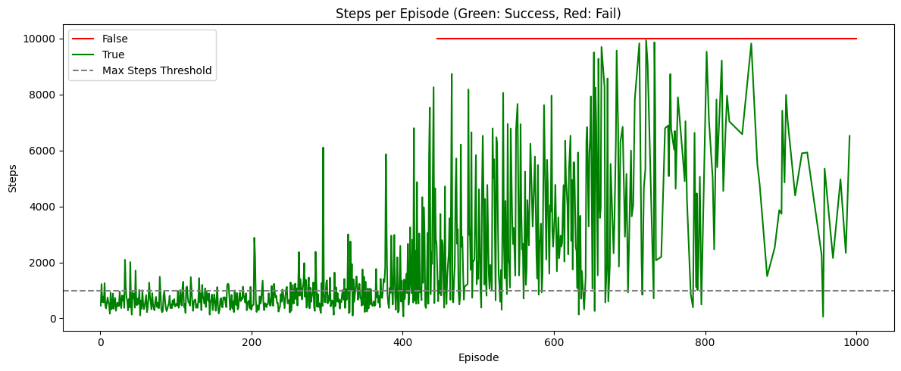
RL Plays Game of Thrones
A Game of Trials and Errors

Slide 7

RL Plays Game of Thrones
The Path Becomes Clear
Y
0
1
2
3
4
5
Size of the Environment = 6 X 6
Initial Agent State (A) = (0,0)
Goal State (G) = (5,5)
Number of Hell States (H) = 4
Number of Reward States (R) = 2
Number of Kingdoms (K) = 3
X
0
1
2
3
4
5
A |  |  | H |  | K₃
 |  |  |  |  | R
 | H |  |  | H
R |  |  | K₁
 | K₂ |  | H |  | G

Slide 8
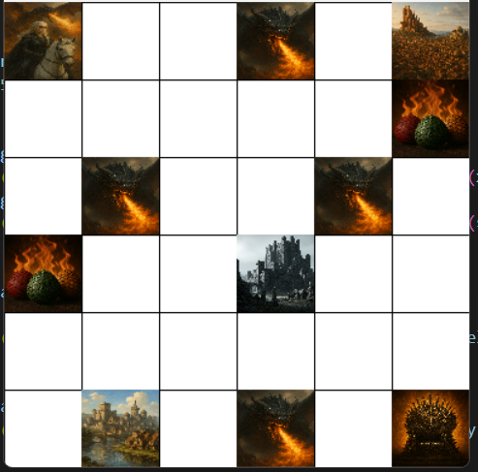
RL Plays Game of Thrones
Chapter 2: Introduction to the Final Environment
Kings Landing (K₃)
Daenerys Targaryen (A)
Harrenhall (K₁)
Dragon Eggs (R)
Riverlands (K₂)
Iron Throne (G)
Dragon (H)

Slide 9
RL Plays Game of Thrones
Introduction to the Final Environment
Action Space: 4 discrete actions — [Up, Down, Right, Left]
Pre-Goal Fulfillment Condition: The agent must visit and capture all three kingdoms before reaching the final goal (Iron Throne).
Solution Strategy: The solution employs four separate Q-tables, each responsible for a different phase of the task:
Q₁: Navigation until Harren hall is captured
Q₂: Activated after Harren hall, until Riverlands is captured
Q₃: Activated after Riverlands, until Kings Landing is captured
Q₄: Final path planning from Kings Landing to the Iron Throne
Q-table Switching Logic: After each milestone (kingdom capture), a flag is triggered, prompting the agent to switch to the corresponding Q-table for the next phase.

Slide 10
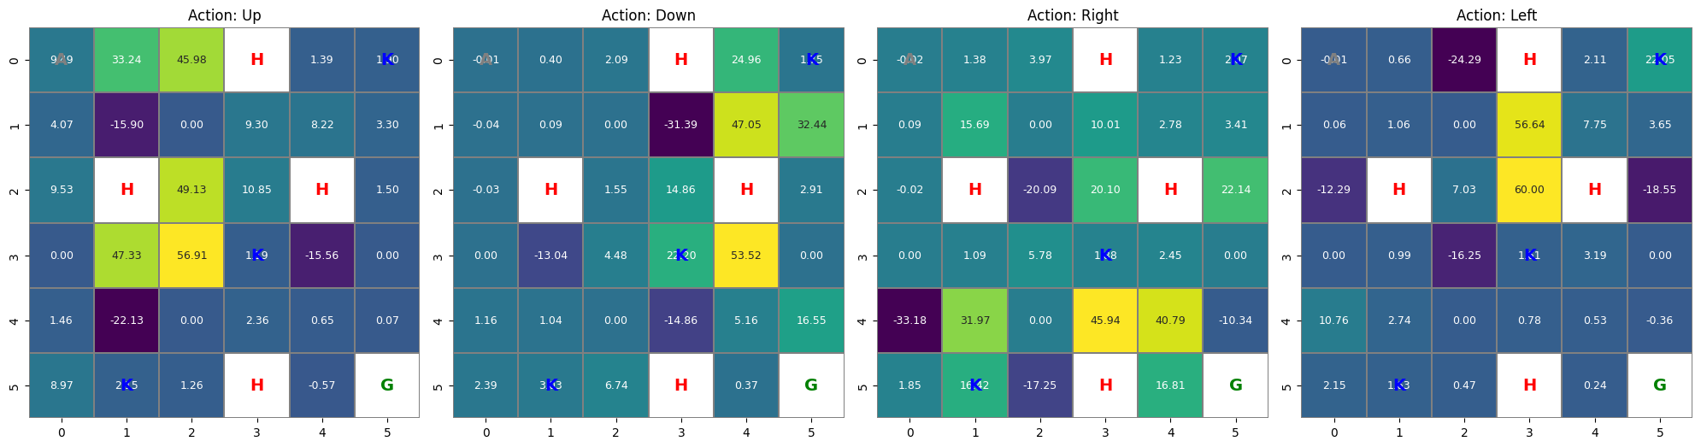
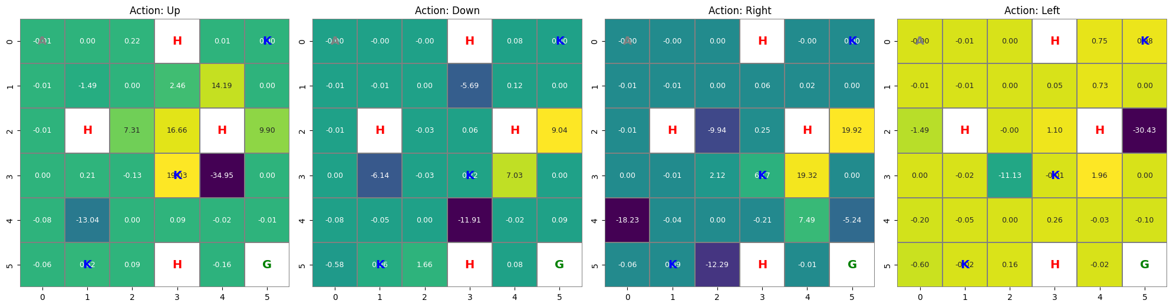
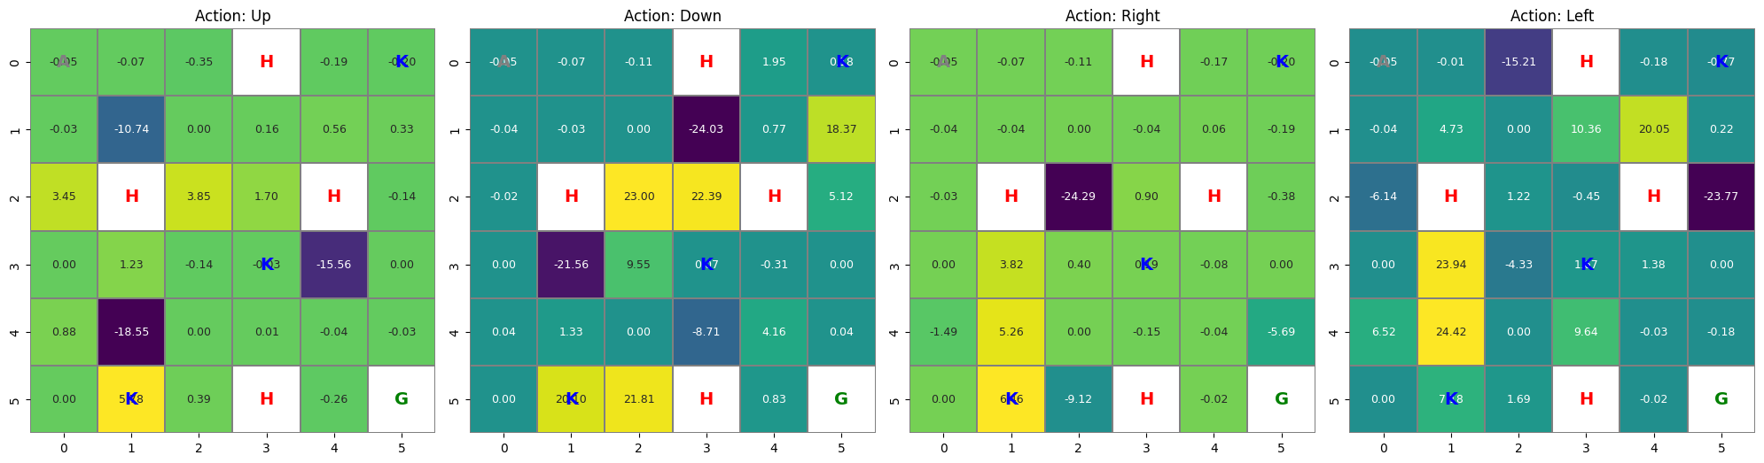
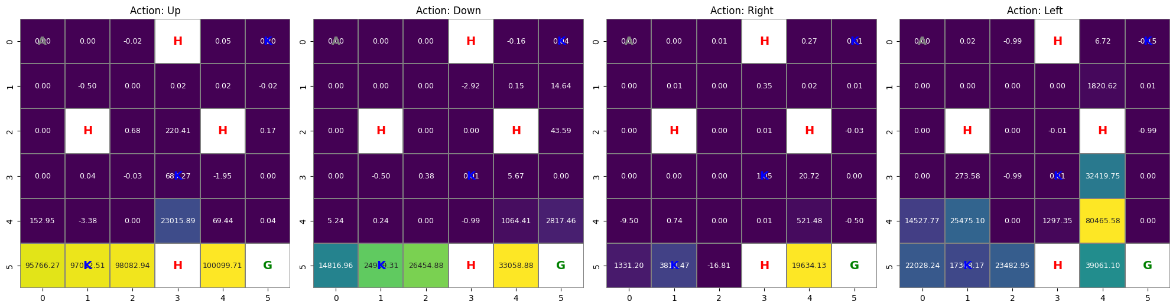
RL Plays Game of Thrones
Chapter 3: Daenerys Charts Her Path
Kingdom 2 (K₂)
Kingdom 1 (K₁)
Kingdom 3 (K₃)
The Iron Throne (G)

Slide 11
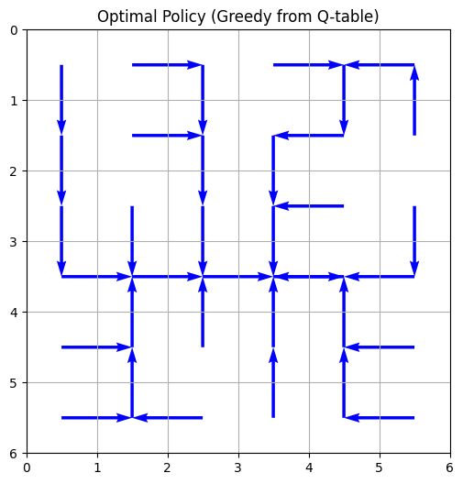
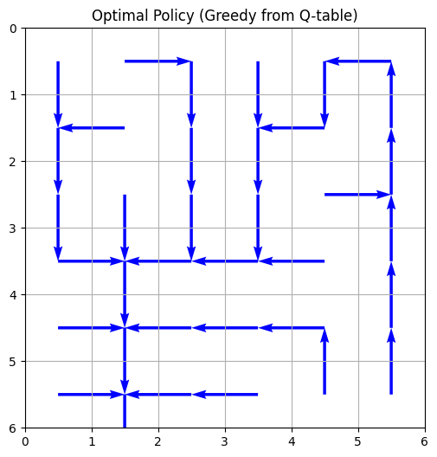
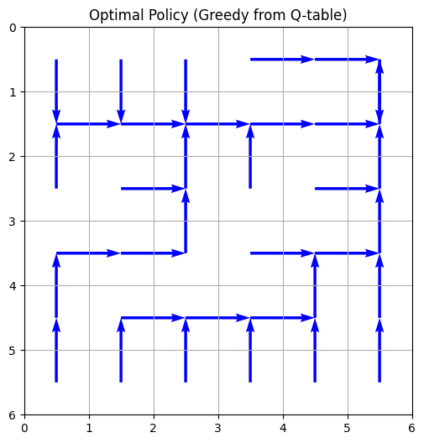
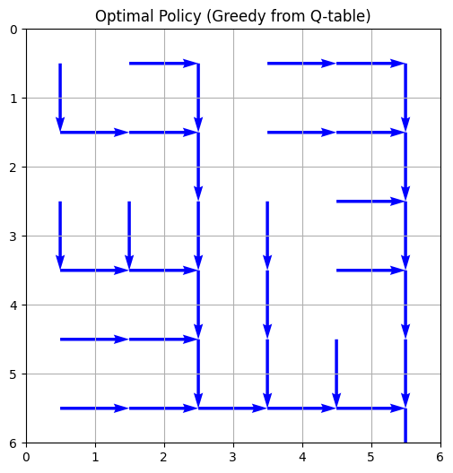
RL Plays Game of Thrones
Daenerys Charts Her Path
Kingdom 1 (K₁)
Kingdom 2 (K₂)
Kingdom 3 (K₃)
The Iron Throne (G)
The agent converges faster and demonstrates clear phase-wise behavior aligned with the sub-goals.
The agent’s performance improves significantly, with smoother transitions and better decision-making.

Slide 12
Building and Training a DQN Agent
Introduction to the Problem
Problem Overview:
Objective: Train a DQN agent to reach the goal from a fixed start point (0.1, 0.5)
Constraint: The agent must reach the goal consecutively for 100 episodes
Training Criteria:
Epsilon decay down to 0.1 (fixed)
After reaching ε = 0.1, the agent should consistently succeed for 100 episodes

Slide 13
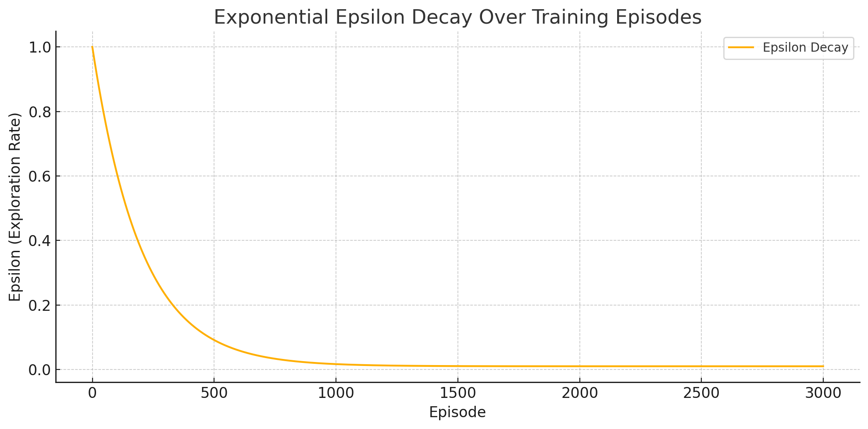
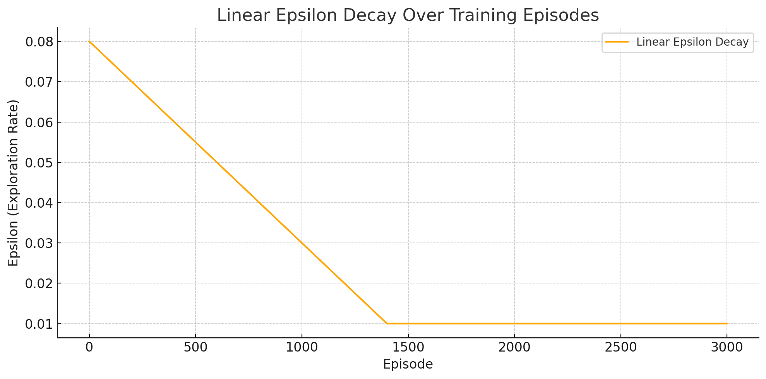
Building and Training a DQN Agent
Epsilon Decay

Slide 14
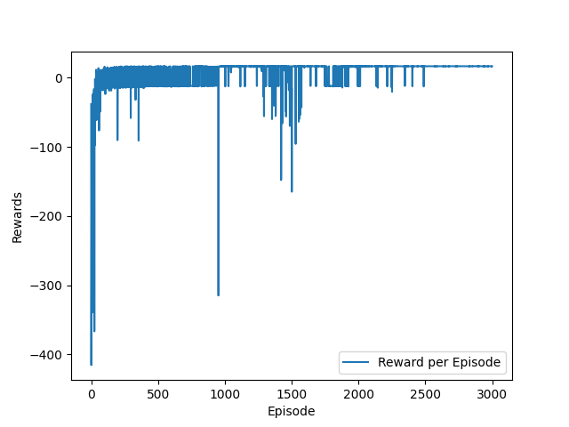
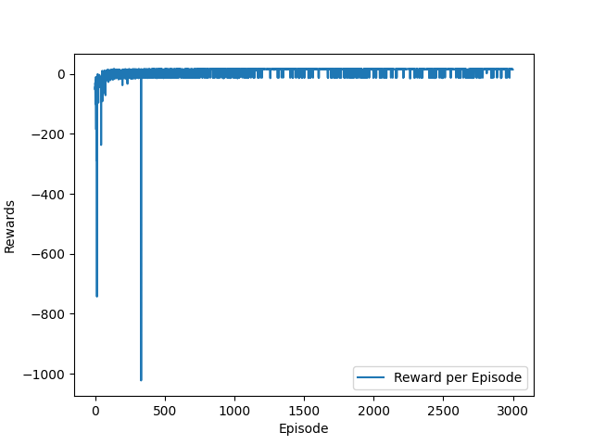
Building and Training a DQN Agent
Training outputs
Min Epsilon = 0.01
Min Epsilon = 0.1

Slide 15
Thank You

